Slide 1



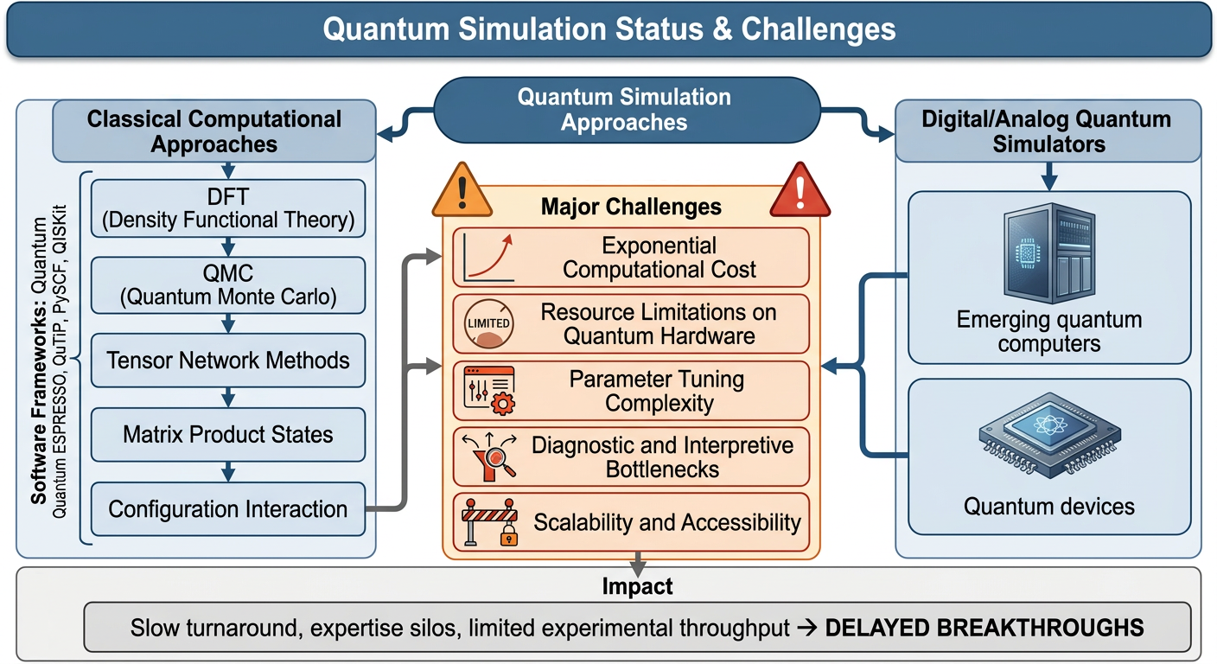
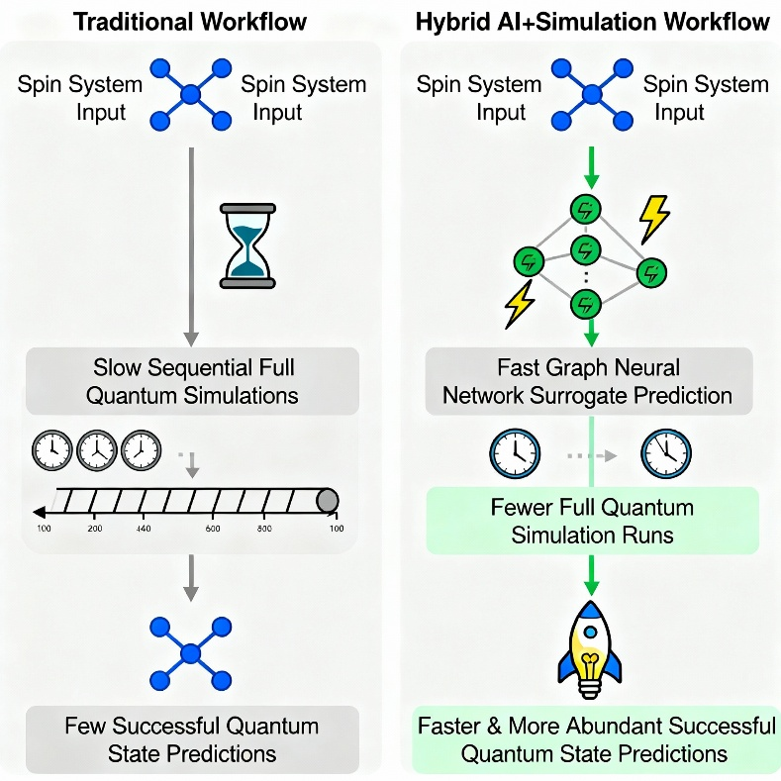
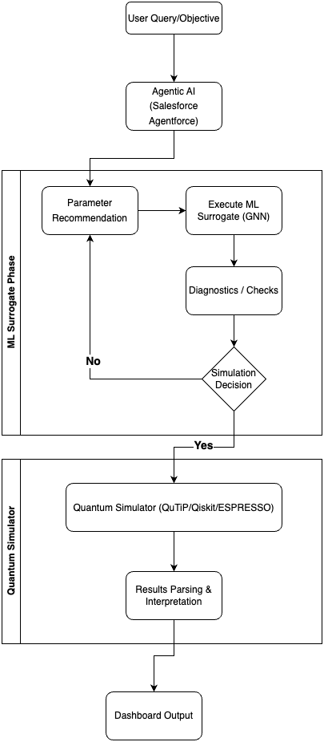
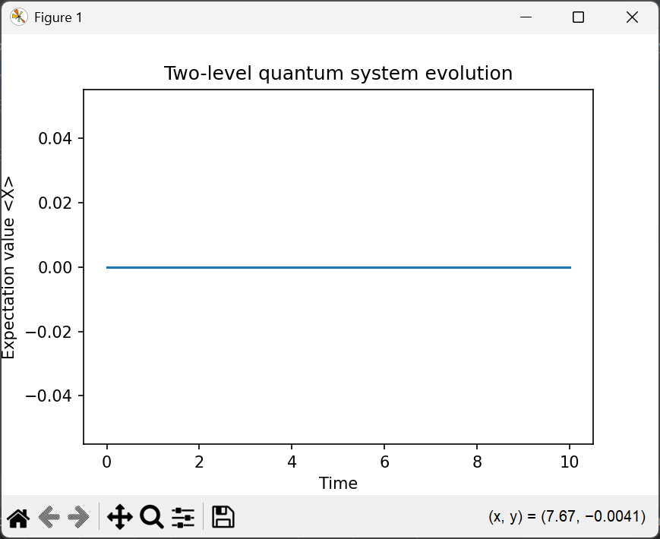
International Conference On Materials for Electronics, Energy, Quantum and Biomedical Technologies (MQUBIT 2026)
AI-Assisted Quantum Simulation & Modelling with Salesforce Agentforce
2026
Shriya Desai, Dr. Ankit Shrivastava, Dr. Arpita Baronia
Manipal University Jaipur, Jaipur, India
Corresponding Author Email:
shriya.2427030171@muj.manipal.edu
Abs ID: 445
Introduction
To find solutions to the many-body Schrodinger equation or model quantum dynamics and compute electronic structure or molecular properties is very complex and requires a lot of time and effort.
Quantum simulation has proved to be an indispensable tool, which helps maximize the research.
However, many challenges still need to be overcome.
Solution
Traditional Quantum Simulation workflows can be integrated with AI/ML to revolutionize the field.
ML surrogate models, based on Graph Neural Networks(GNNs) can screen parameters to only allow simulation of promising candidates. It predicts quantum properties and solutions in new scenarios and is trained on pre-existing sets of experimental or simulated results.
Objectives
Demonstrating power of AI/ML in optimization of quantum simulations by reducing computational cost.
Integrating an agentic AI to convert scientific workflows into conversational interactions for scientists.
Allowing students or non-experts to run quantum simulations without in depth numerical or coding knowledge.
Creating a blueprint for future agentic AI assisted scientific workflows.
Methodology
Used Python(QuTiP/Qiskit, Pytorch) to build backend for quantum simulation and surrogate models
Trained the GNN based surrogate model constructed by representing each molecule as a graph, using existing preprocessed quantum datasets.
Designed and implemented REST APIs to support parameter recommendations and surrogate predictions
Integrated agentic AI that orchestrates user interactions and ML surrogate calls, identifying optimal conditions and thresholds thus triggering quantum simulation, and finally interpreting the results.
Testing all modules separately, and then combining them into a coherent platform.
Results
End-to-End project workflow validation with working quantum simulations, ML surrogate predictions and UI showing parameter options and results display.
Conclusion and Interpretation
Surrogate models help in parameter screening by providing predictions based on given thresholds.
Agentic AI simplifies complex scientific workflows by guiding surrogate predictions and simulations, and interpreting the results, instead of everything being done manually
Future Work
Adapting agentic AI assisted workflows into other scientific domains such as quantum chemistry, materials discovery, etc.
Acknowledgement
I would like to thank my mentor Dr. Ankit Shrivastava for his meaningful assistance, tireless patience and guidance. I would like to extend my appreciation towards Dr. Arpita Baronia for her continued support. I would also like to thank my family for their moral support and guidance.
Contact
Shriya Desai – 7020737036
Dr. Ankit Shrivastava - 7726926244
References
Bensoussan, A., Chachkarova, E., Even-Mendoza, K., Fortz, S., & Lenihan, C. (2025). AccelerQ: Accelerating quantum eigensolvers with machine learning on quantum simulators. Proceedings of the ACM on Programming Languages, 9(OOPSLA2), Article 354, 1–31. https://doi.org/10.1145/3763132
Zou, Y., Cheng, A. H., Aldossary, A., Bai, J., Leong, S. X., Campos-Gonzalez-Angulo, J. A., ... & Aspuru-Guzik, A. (2025). El Agente: An autonomous agent for quantum chemistry. Matter, 8(7).
https://www.spinquanta.com/news-detail/spinq-quantum-artificial-intelligence-lab-research-project-overview
Carleo, G., & Troyer, M. (2017). Solving the quantum many-body problem with artificial neural networks. Science, 355(6325), 602–606. https://doi.org/10.1126/science.aag2302
Shin, W., Souza, R., Rosendo, D., Suter, F., Wang, F., Balaprakash, P., & da Silva, R. F. (2025). The (R)evolution of scientific workflows in the agentic AI era: Towards autonomous science. In Proceedings of the 20th Workshop on Workflows in Support of Large-Scale Science (WORKS ’25) (pp. 2305–2316). Association for Computing Machinery. https://doi.org/10.1145/3731599.3767580

